Slide 1
Mobile Computing
Wireless Communication Systems

Slide 2
DECT
Digital Enhanced Cordless Telecommunications
Also called
Digital European cordless telephone and
Digital European cordless telecommunications.
Replaces older analog cordless phone systems such as CT1 and CT1+.
Mainly used in offices, on campus, at trade shows, or in the home.
Bridge the last few hundred meters between a new network operator and customers.

Slide 3
Features and Characteristics
Local mobility in an in-building Private Branch Exchange (PBE)
Configured around an open standard.
Allows to interconnect wide area fixed or mobile networks.
Range of DECT is limited to about 300 m from the base station.
Can offer its service to some 10,000 people within one km2.
Provides low power radio access
Each station has an average transmission power of only 10 mW with a maximum of 250 mW.
The digital modulation scheme is GMSK

Slide 4
DECT Architecture
Based on OSI principles
A control plane (C-Plane) and user plane (U-Plane) use the services by lower layers.
Able to page upto 6000 subscribers
No need of cell registration
Designed for radio local loop/ metropolitan are access.
Uses dynamic channel allocation.
Can also handle handover,
But it was not designed to work at a higher speed.

Slide 5
Contnd..
Physical Layer
Uses FDMA/TDMA/TDD radio transmission method.
Offering 120 full duplex channels.
Within a slot one out of 10 carrier frequencies is used dynamically.
Each frame (10ms duration) being divided into 24 slots using TDMA
12 slots are used as uplink, 12 slots as downlink

Slide 6
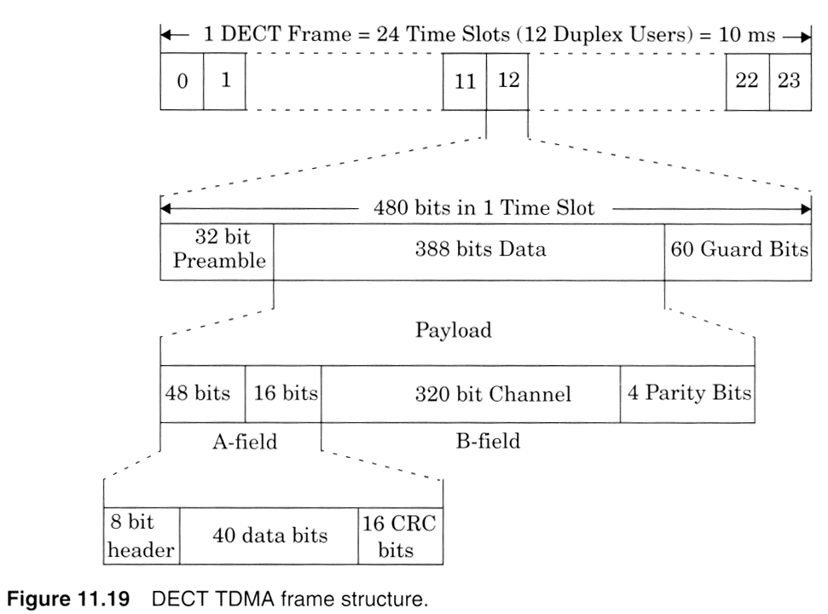

Slide 7
Contnd..
Medium Access Control (MAC) Layer
Consists of paging channel and a control channel
Transfers signaling information to the C-Plane.
U-Plane is served with channels for the transfer of user information.
The normal bit rate is 32kbps
Supports hand off and a broadcast beacon service
Enables all idle portable units to find the best fixed radio port to lock ratio.

Slide 8
Contnd..
Data Link Control (DLC) Layer
Provides reliable data links to the n/w layer
Divides the logical and physical channels into time slots for each user.
Provides formatting and error protection/correction for each time slot.

Slide 9
Contnd..
Network Layer
Main signaling layer.
Based on ISDN and GSM protocols
Provides
Call control
Circuit switched services selected from one of the DLC services
Connection-oriented message services and mobility management

Slide 10
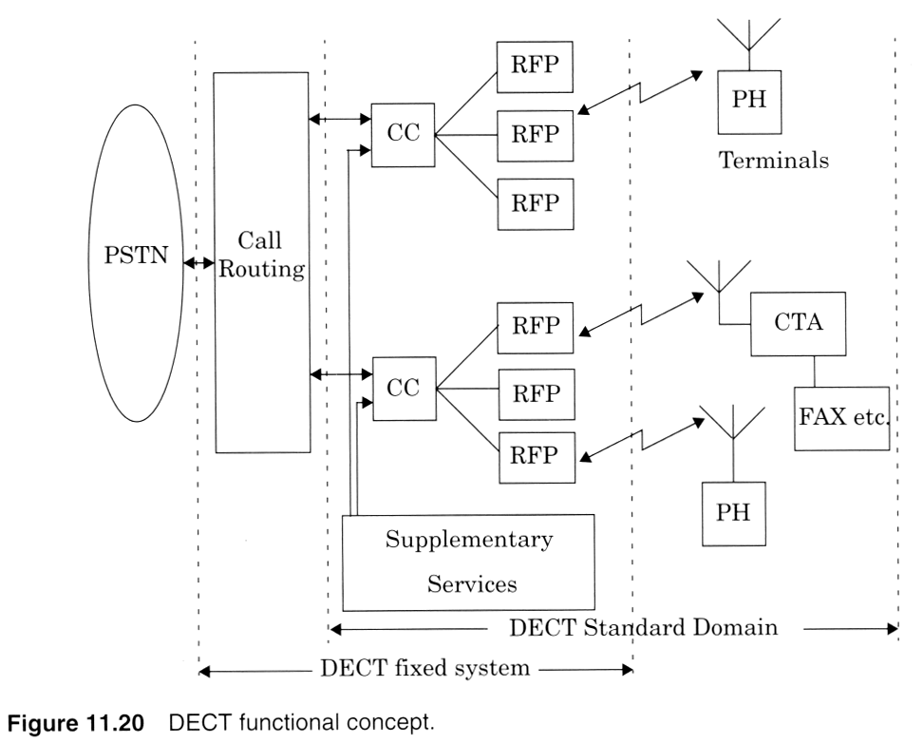
Functional Concepts

Slide 11
Contnd..
Portable Handset (PH)
Mobile handset or terminal, cordless terminal adapters (CTAs)- fax or video communications.
Radio Fixed Part (RFP)
Supports the physical layer of the DECT common air interface.
Covers one cell in the microcellular system.
Radio transmission between RFP and PH
Multi Carrier TDMA
Dulplex operation- using TDD

Slide 12
Contnd..
Cordless Controller (CC or Cluster Controller)
Central Control Unit
Handles the MAC, DLC and network layers for one or a cluster of RFPs
Speech coding is done in the CC using 32kbps ADPCM.
Network-Specific Interface Unit
Supports the call completion facility in a multi-handset environment.
Supplementary Services
Provides centralized authentication and billing
Provides mobility management in PABX n/w.

Slide 13
DECT Radio Link
DECT band-1880Mhz to 1900MHz
10 channels from 1881.792 to 1897.344
With 1728kHz spacing
Base station supports FHMA on top of the TDMA/TDD structure.
Each slot may be assigned to a different channel
Exploit the advantage of FH
Avoid interference

Slide 14
Contnd..
Channel Types
User data: B-field
320 bits+4bits parity
32kbps per user
Control data: A-field
64 bits
Assigned to one of the 4 logical channels.
48 bits+16bits CRC
6.4 kbps per user
Relies on error detection and retransmission

Slide 15
Contnd..
Speech Coding
Speech is digitized into PCMusing 8kHz rate
Speech samples are ADPCM encoded at 32kbps.
Channel Coding
No channel coding and interleaving
Frequency hopping
End-to-end delay is tolerable
Modulation
Tightly filtered GMSK
Antenna Diversity
Implemented using 2 antennas.
Best signal for each slot is selected
Power or quality measured
Fading and interference minimized.
Notes:
ADPSM-Adaptive Digital Pulse Code Modulation

Slide 16
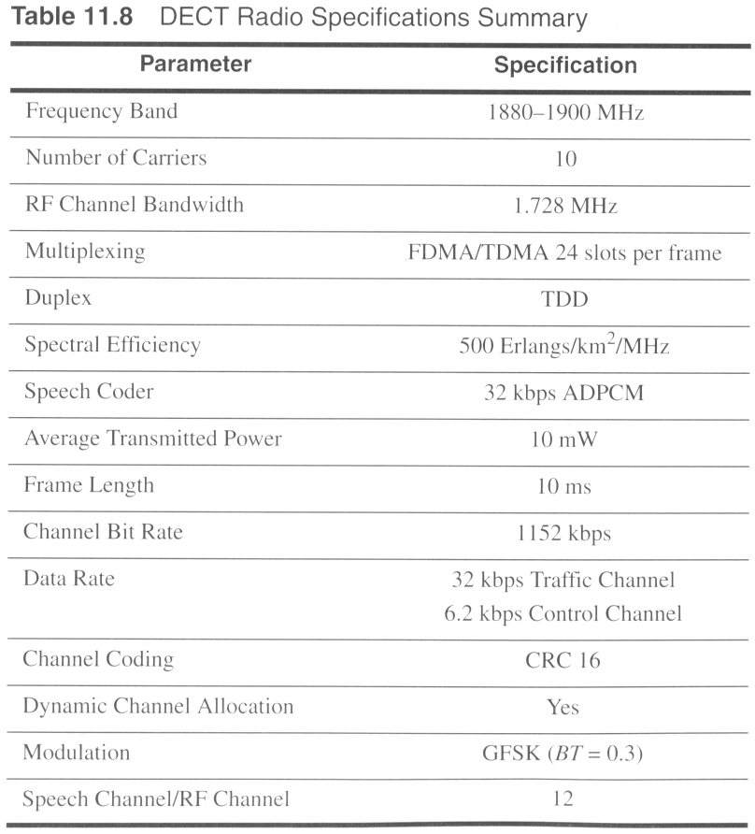

Slide 17
Personal Access Communication Systems (PACS)
3rd Gen personal Communication System
Provides coverage within 500 meter range.
Objective is to integrate all forms of wireless local loop communications into one system with full telephone features.
A slightly altered proposed features
10 TDMA/FDM time slots/2ms frame
500 kbps channel data rate
350kHz BW using QPSK->π/4 QPSK

Slide 18
System Architecture
Operates in licensed or unlicensed PCS band.
May be connected to a PBX or Centrex
Served by a Central Office in residential applications.
Main Components
Subscriber Unit (SU)
Radio Ports (RPs)
Radio Port Control Unit (RPCU)
Access Manager(AM)

Slide 19
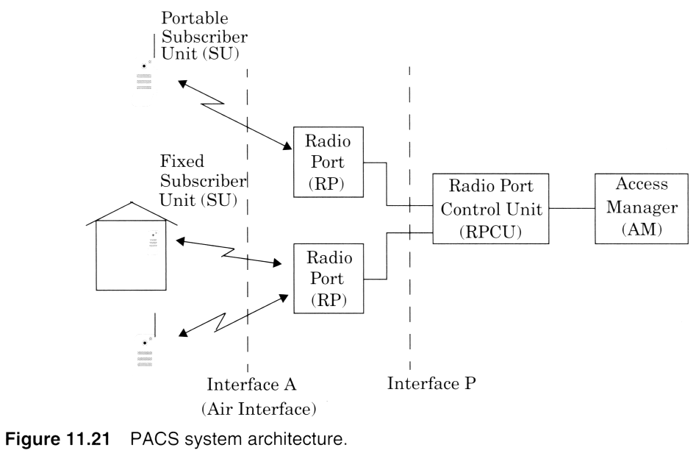
Contnd..

Slide 20
Contnd..
Interfaces
A:
The air interface, connection b/w SU&RP
P:
Provides the protocols required to connect the SUs through the RPs to the RPCU
Connects the RPCU with its RPs by using an Embedded Operations Channel (EOC)
Standards contains a fixed distribution n/w and n/w intelligence.
Only the last 500m of the distribution n/w is designed to be wireless.

Slide 21
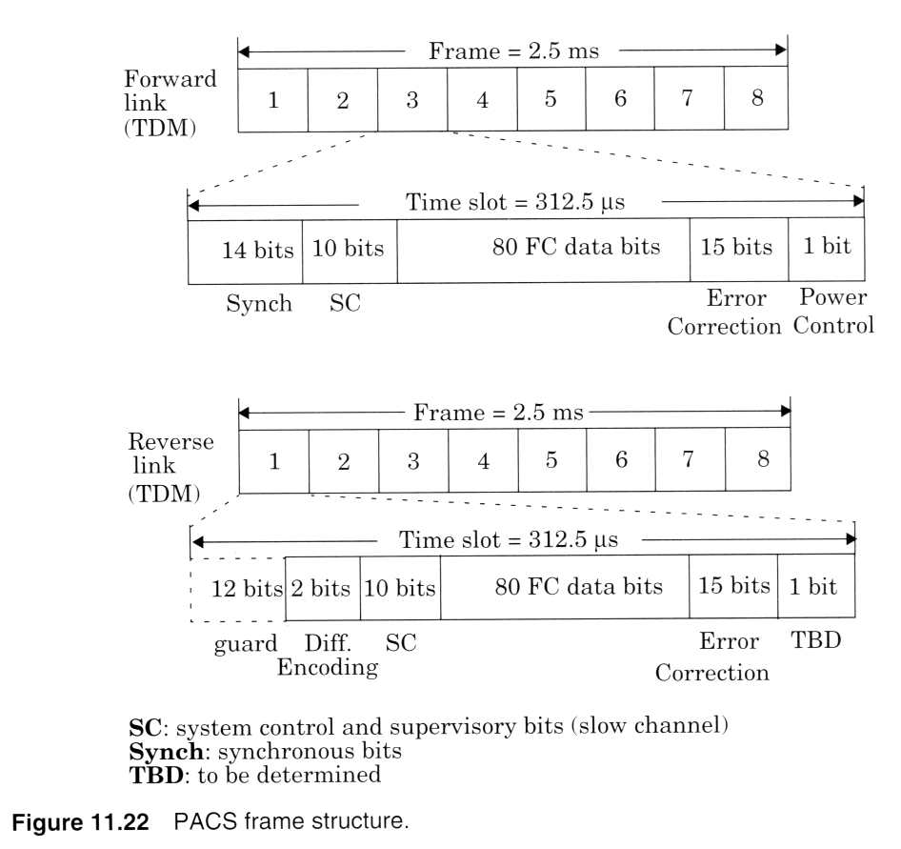
Frame Structure

Slide 22
PACS Radio Interface
Designed for operation in the US PCS band
RF channels are Frequency or Time Division Multiplexed.
BW is 300kHz
TDMA with FDD
8 slots in a 2.0ms frame
Forward Link- 1850MHz to 1910MHz
Reverse Link- 1930MHz to 1990 MHz
The reverse link time slot is offset from its paired forward link time slot by exactly one time slot and 62.5 µs
Unlicensed US PCS band b/w 1920 and 1930 MHz using TDD.

Slide 23
Modulation
π/4 QPSK modulation
RF signal shaped using a raised cosine rolloff shaping filter
99% of the transmitted signal power is contained within a channel BW of 288kHz
Speech Coding
32kbps ADPCM
Provides lox complexity, minimum Cost, and radio link privacy

Slide 24
PACS Channels
Provides system broadcasting channels (SBC)
Used primarily on the forward link to broadcast paging message.
32 kbps SBC provides altering and system information for upto 80000 users.
Synchronization Channel (SYN) & slow Channel (SC)
Used on forward link to synchronize each subscriber unit.
Fast Channel
User information transmission in both links

Slide 25
Multiple Access
Many portable handsets and data terminals may be served from one fixed Radio equipment.
Radio links may be shared among customers on the basis of individual user activity.
Provide wide range of user transmission rates with in a common architecture.
Power Control
Uses adaptive power control to minimize battery drain
To reduce co-channel interference on the reverse path

Slide 26
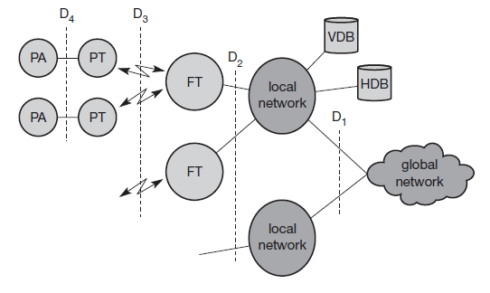
System architecture (Optional)

